Slide 1
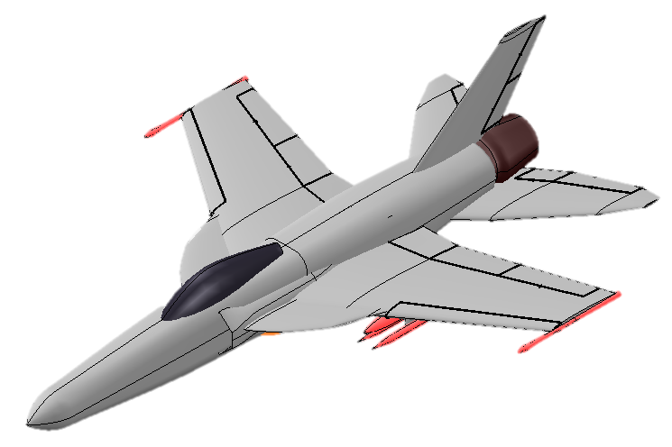
AVION YF-52 Coyote
Preliminary Design Review
Charlie Stone ∙ Valeria Cecena ∙ Quinn Kennerly
Lena Pattamadilok ∙ Jose Hernandez Negrete ∙ Mostafa Hashem

Slide 2
Objective
Objective: Design a carrier-capable supersonic strike aircraft that breaks cost trends.
Performance Requirements:
Mach 1.6-2.0 high altitude dash capability
Carrier compatible configuration
TOGW under 90,000 lbs
700-1000 nm. combat radius
Cut costs lower than:
R&D cost of $2 trillion for F-35 program
Unit flyaway cost of $102 million for F-35C
Ludwigson, Maurer 2024
Notes:
Harvey said: we do not need to include a slide about the RFP; it can just be referenced through the other slides
I added costs to this slide, source:
https://www.gao.gov/blog/f-35-will-now-exceed-2-trillion-military-plans-fly-it-less

Slide 3
Overview: YF-52 Coyote
YF-52 Concept:
R&D cost: $27 billion
Unit cost: $55 million
Gross weight: 36700 lb
Engines: 1
Total thrust: 33500 lb
Wing area: 400 sq ft
F-35 Lightning II:
R&D cost: $2 trillion
Unit cost: $102 million
Gross weight: 50000 lb
Engines: 1
Total thrust: 43000 lb
Wing area: 460 sq ft
F/A-18E/F Super Hornet:
R&D cost: $10 billion
Unit cost $72 million
Gross weight 47000 lb
Engines: 2
Total thrust: 44000 lb
Wing area: 500 sq ft
Hill, 2024
Notes:
Source: previous and https://www.slashgear.com/1689259/f-18-super-hornet-fighter-jet-price/

Slide 4
98% decrease in development cost.
46% decrease in unit cost.
Ludwigson, Maurer 2024

Slide 5
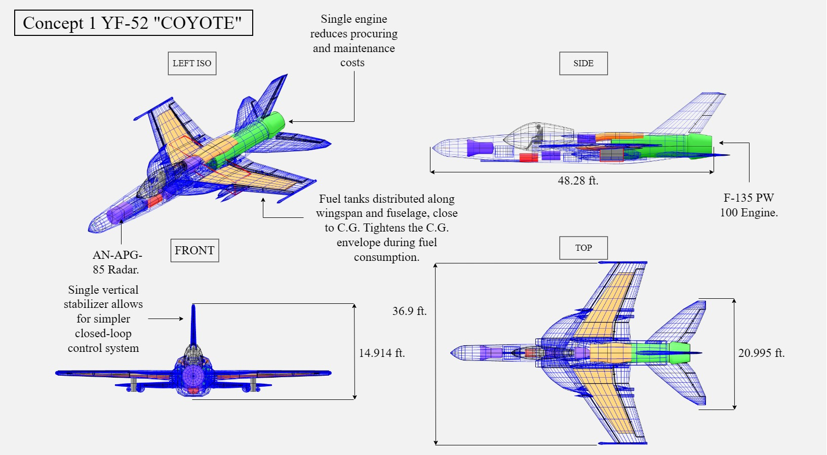
Dimensioned three-view drawing of the COYOTE

Slide 6
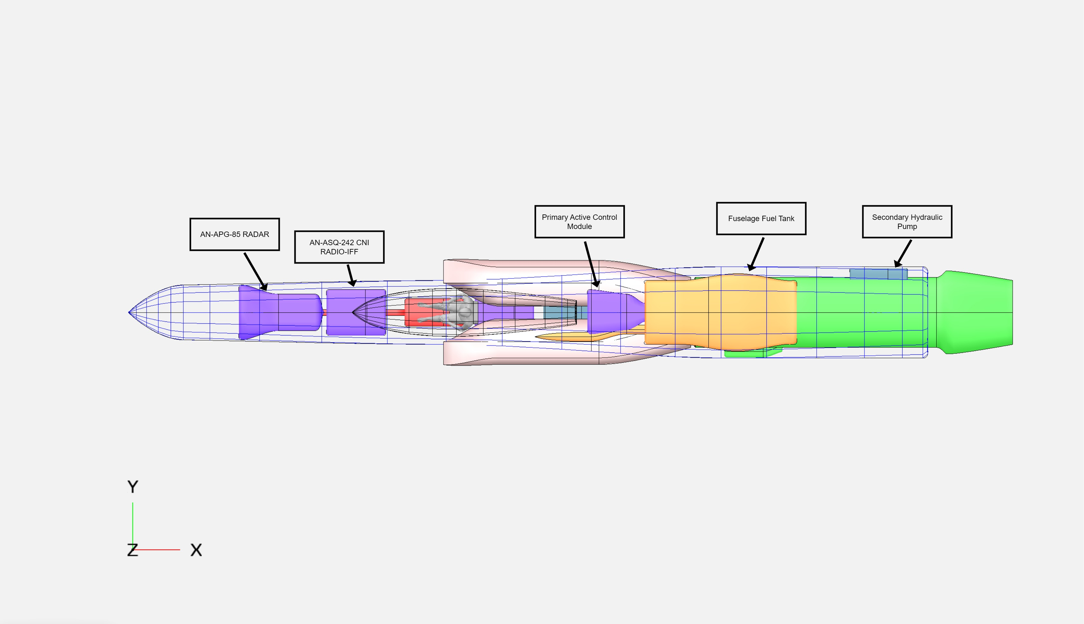
Fuselage

Slide 7
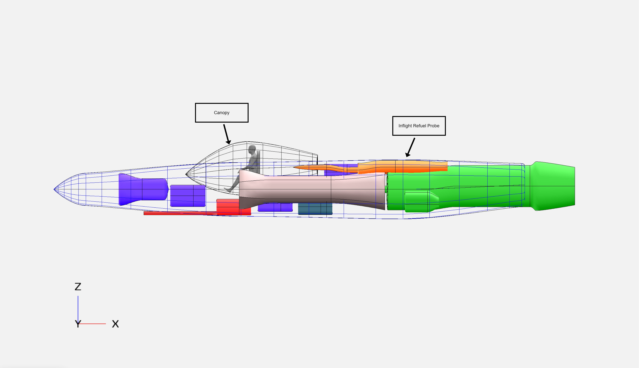
Fuselage

Slide 8
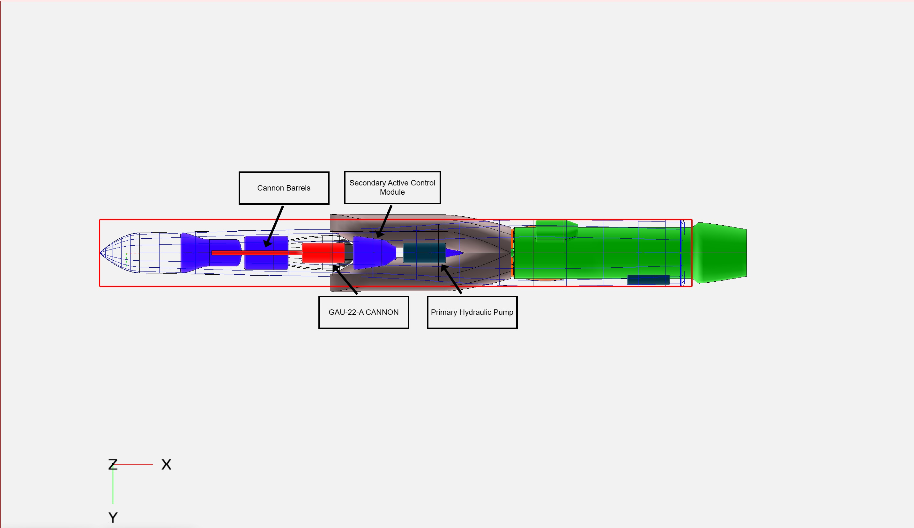
Fuselage

Slide 9
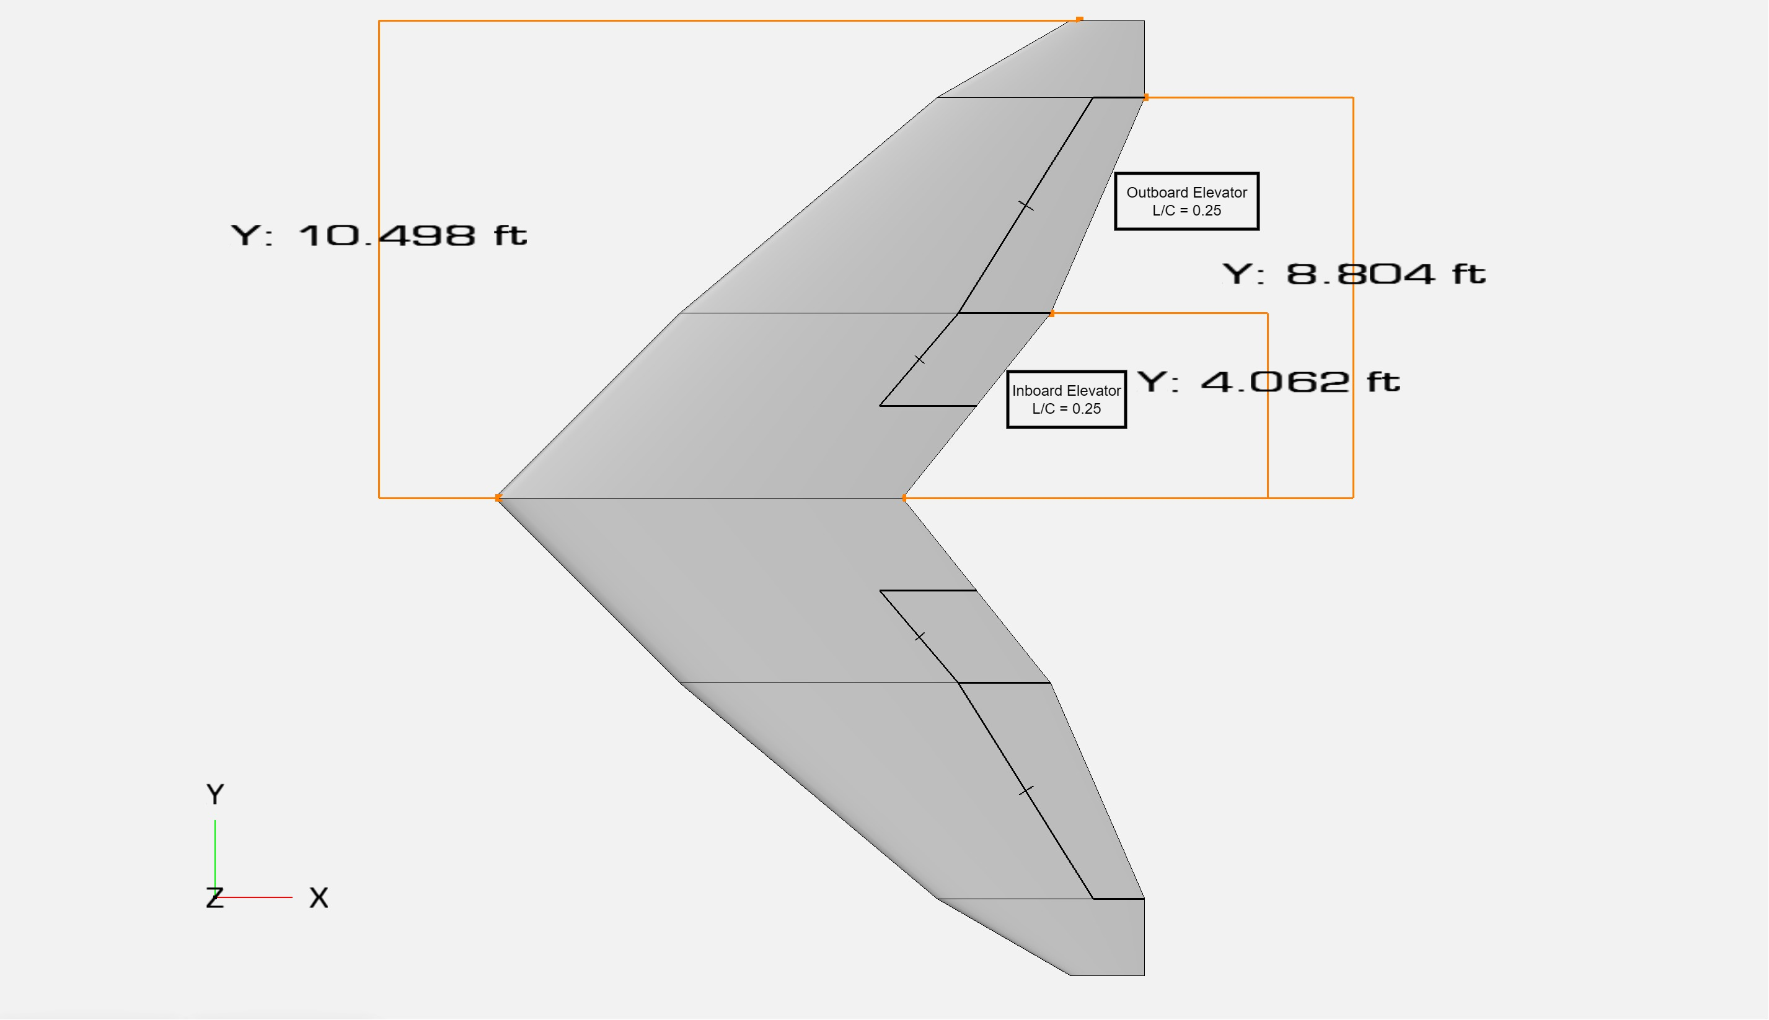
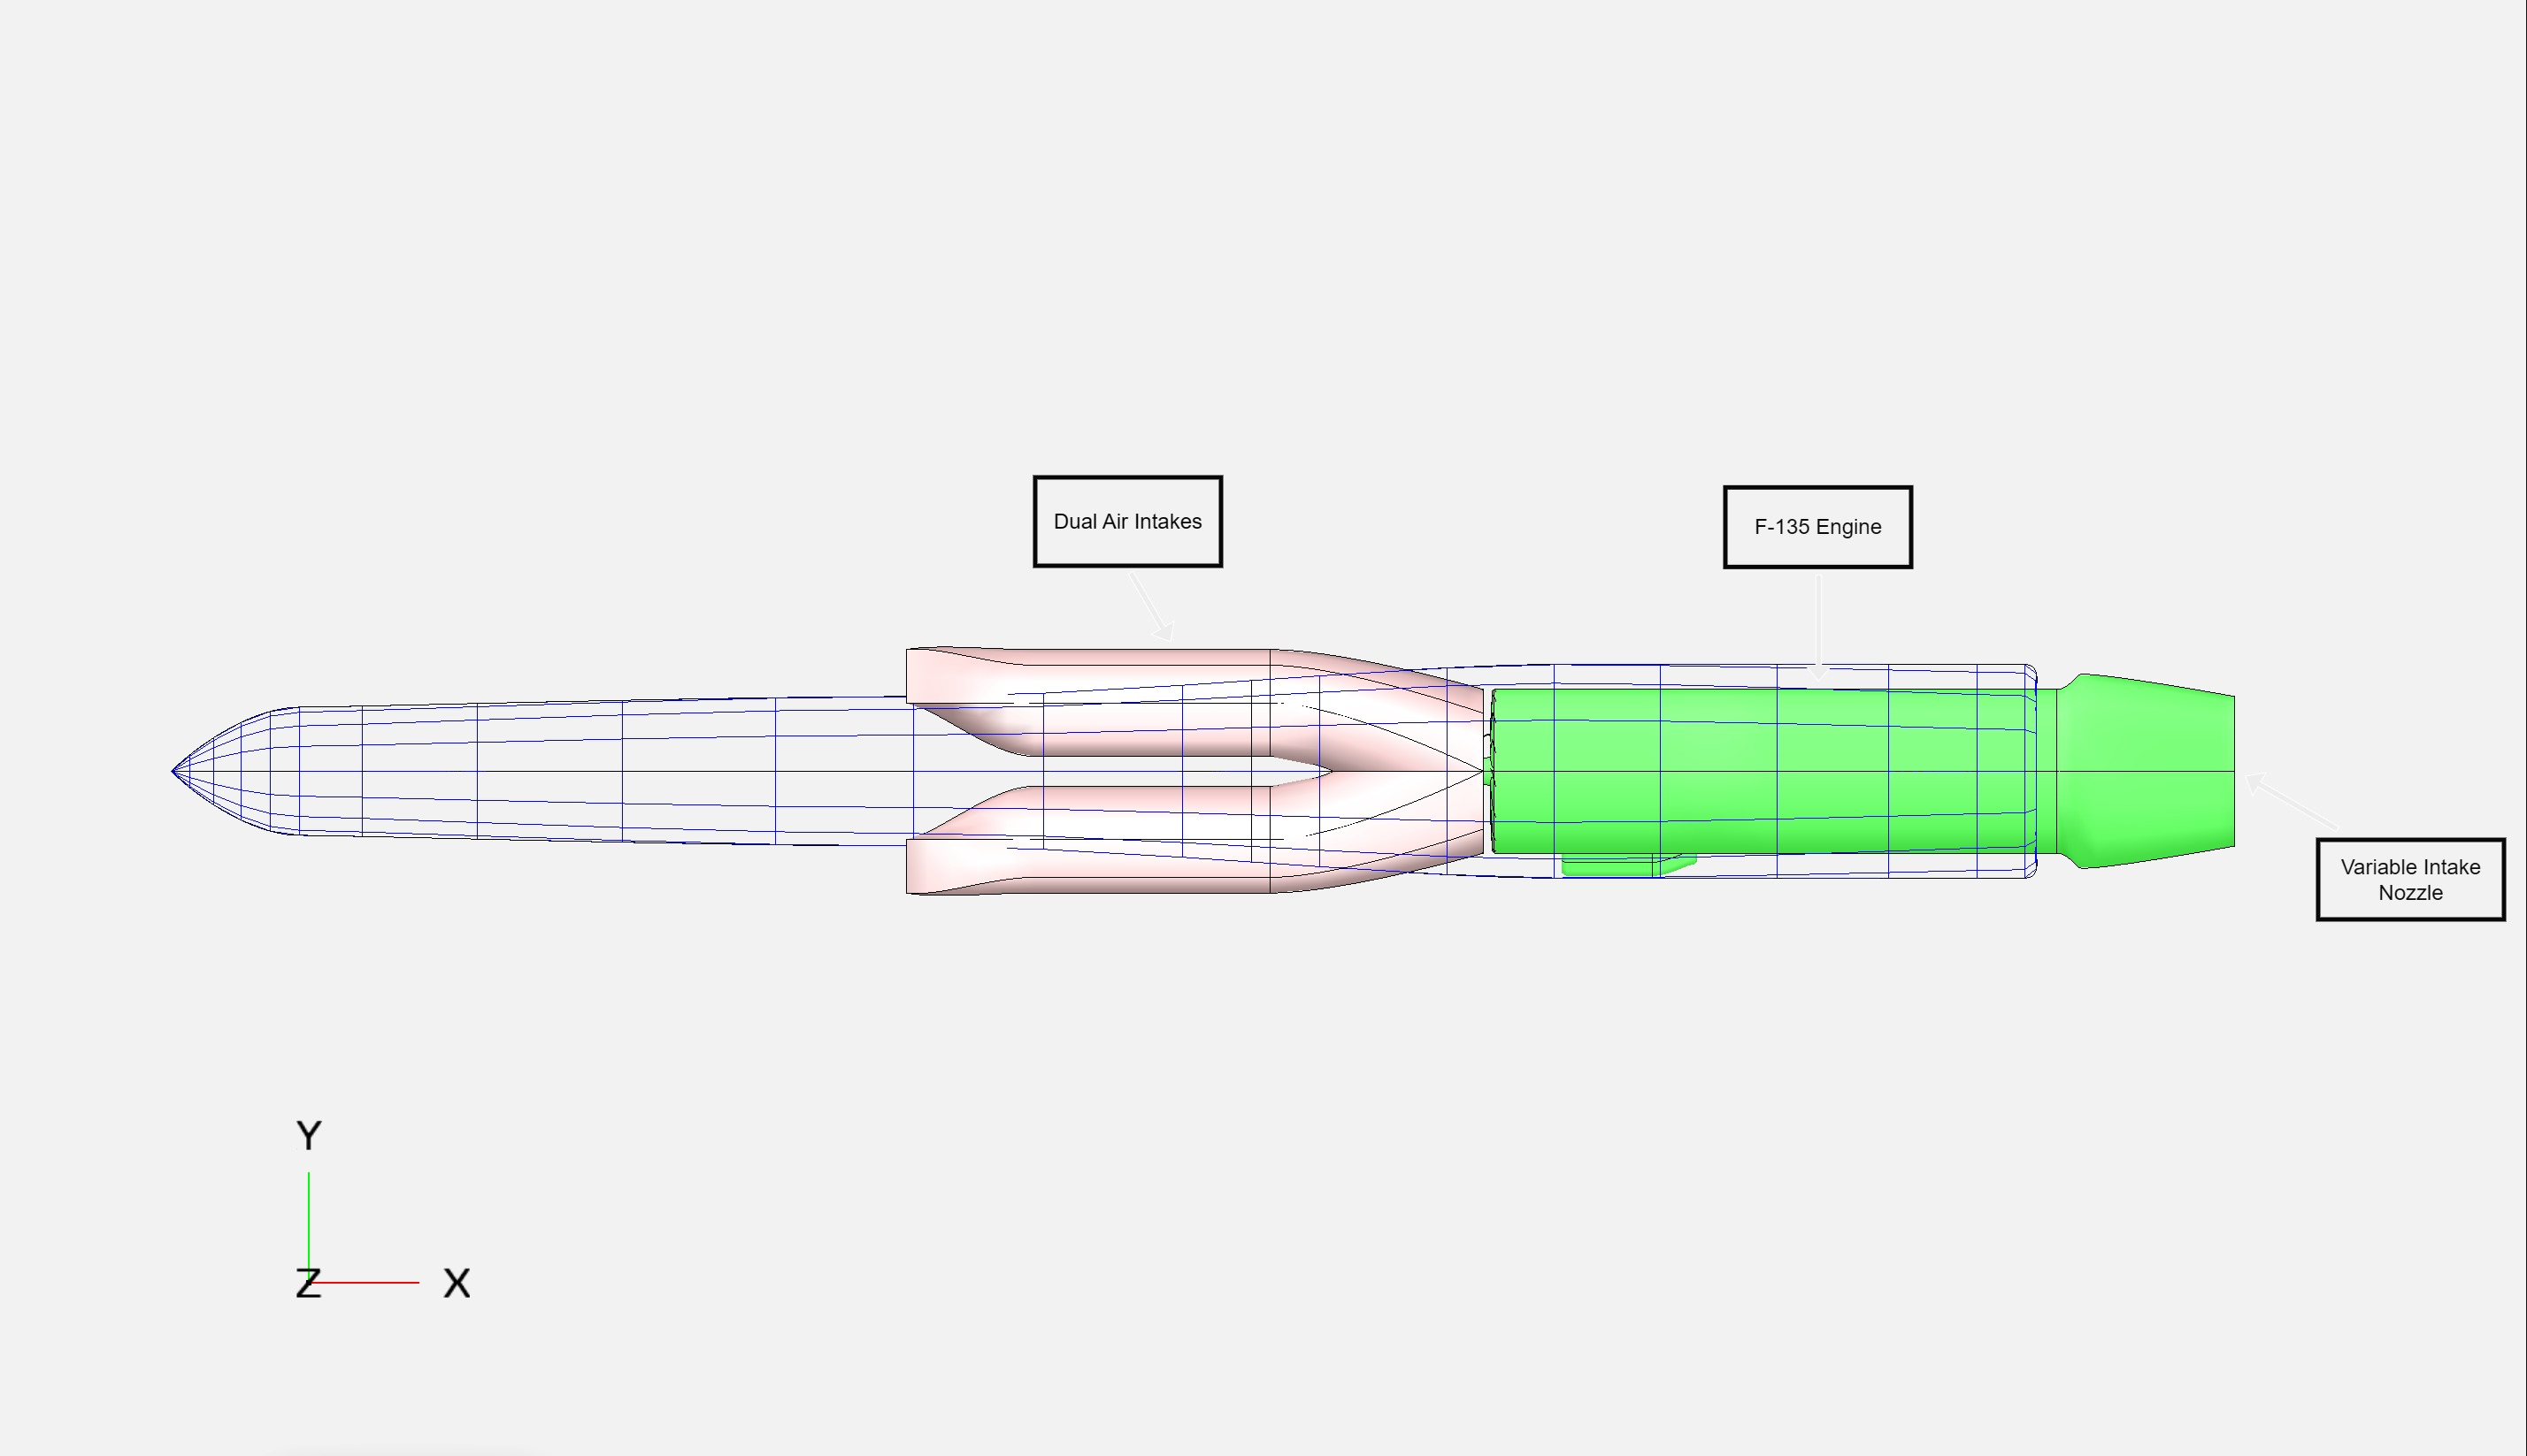
Powertrain

Slide 10
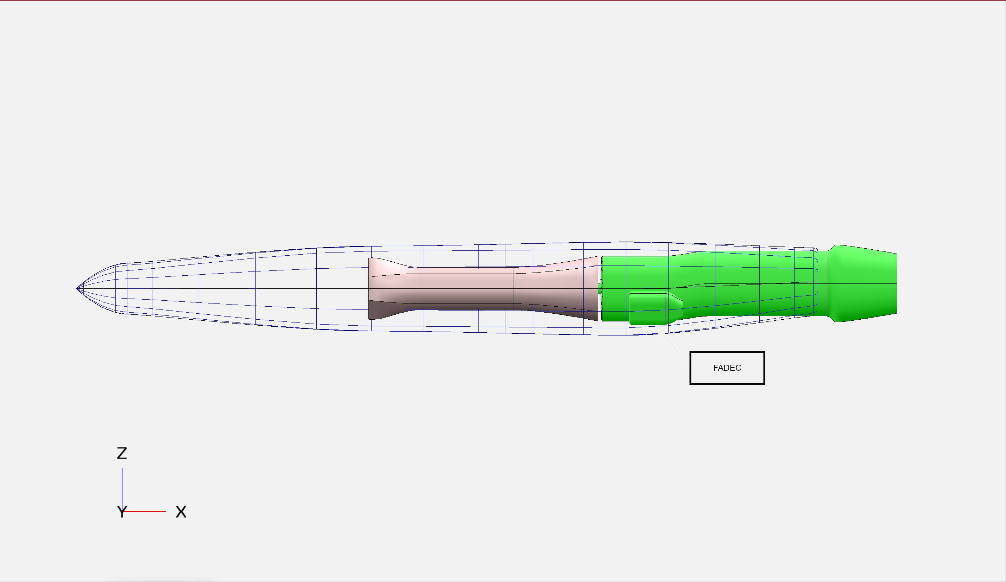
Powertrain

Slide 11
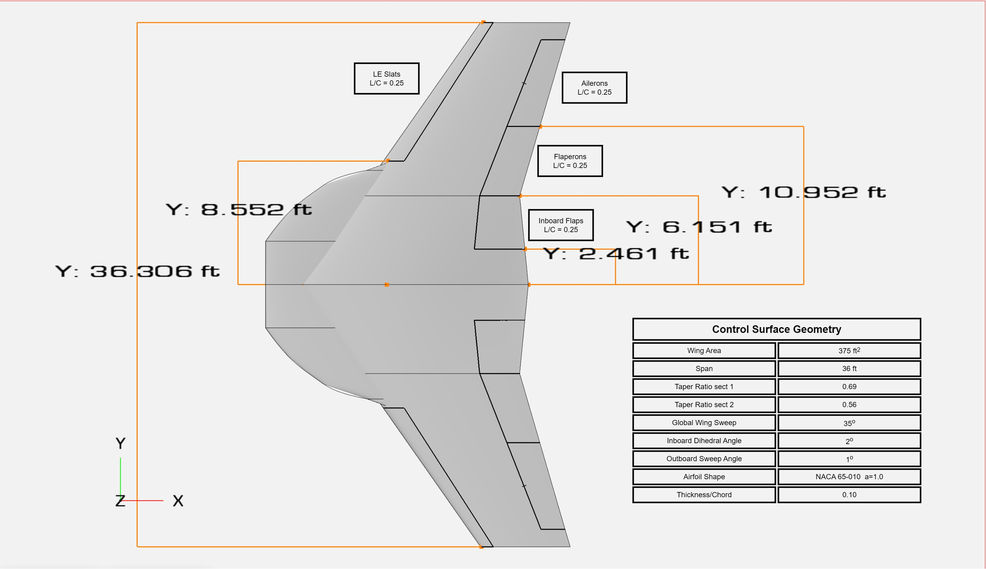
Control Surfaces
400

Slide 12
Empennage (Horizontal)
Notes:
Talk about: redundancy of hstab control surfaces, control authority

Slide 13
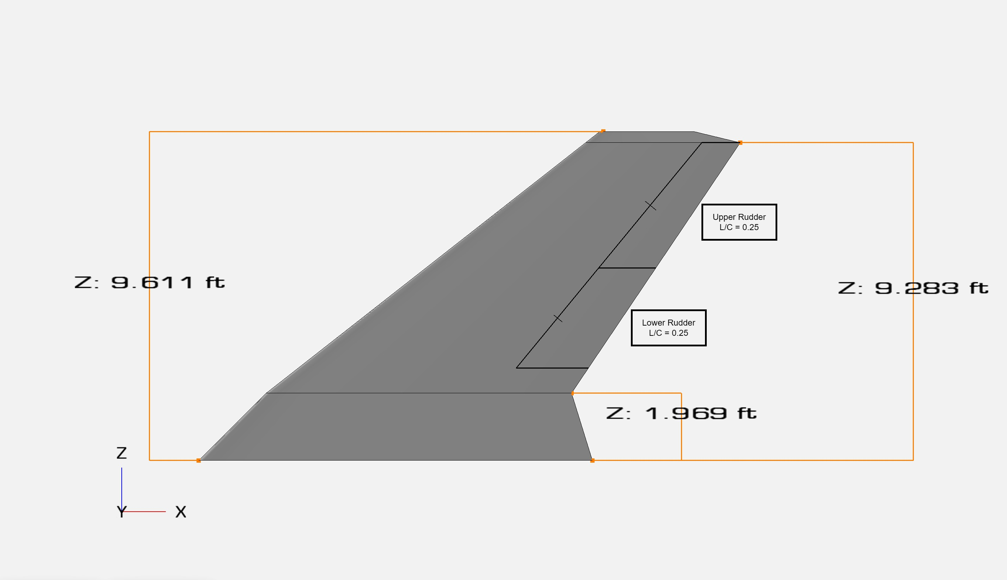
Empennage (Vertical)

Slide 14
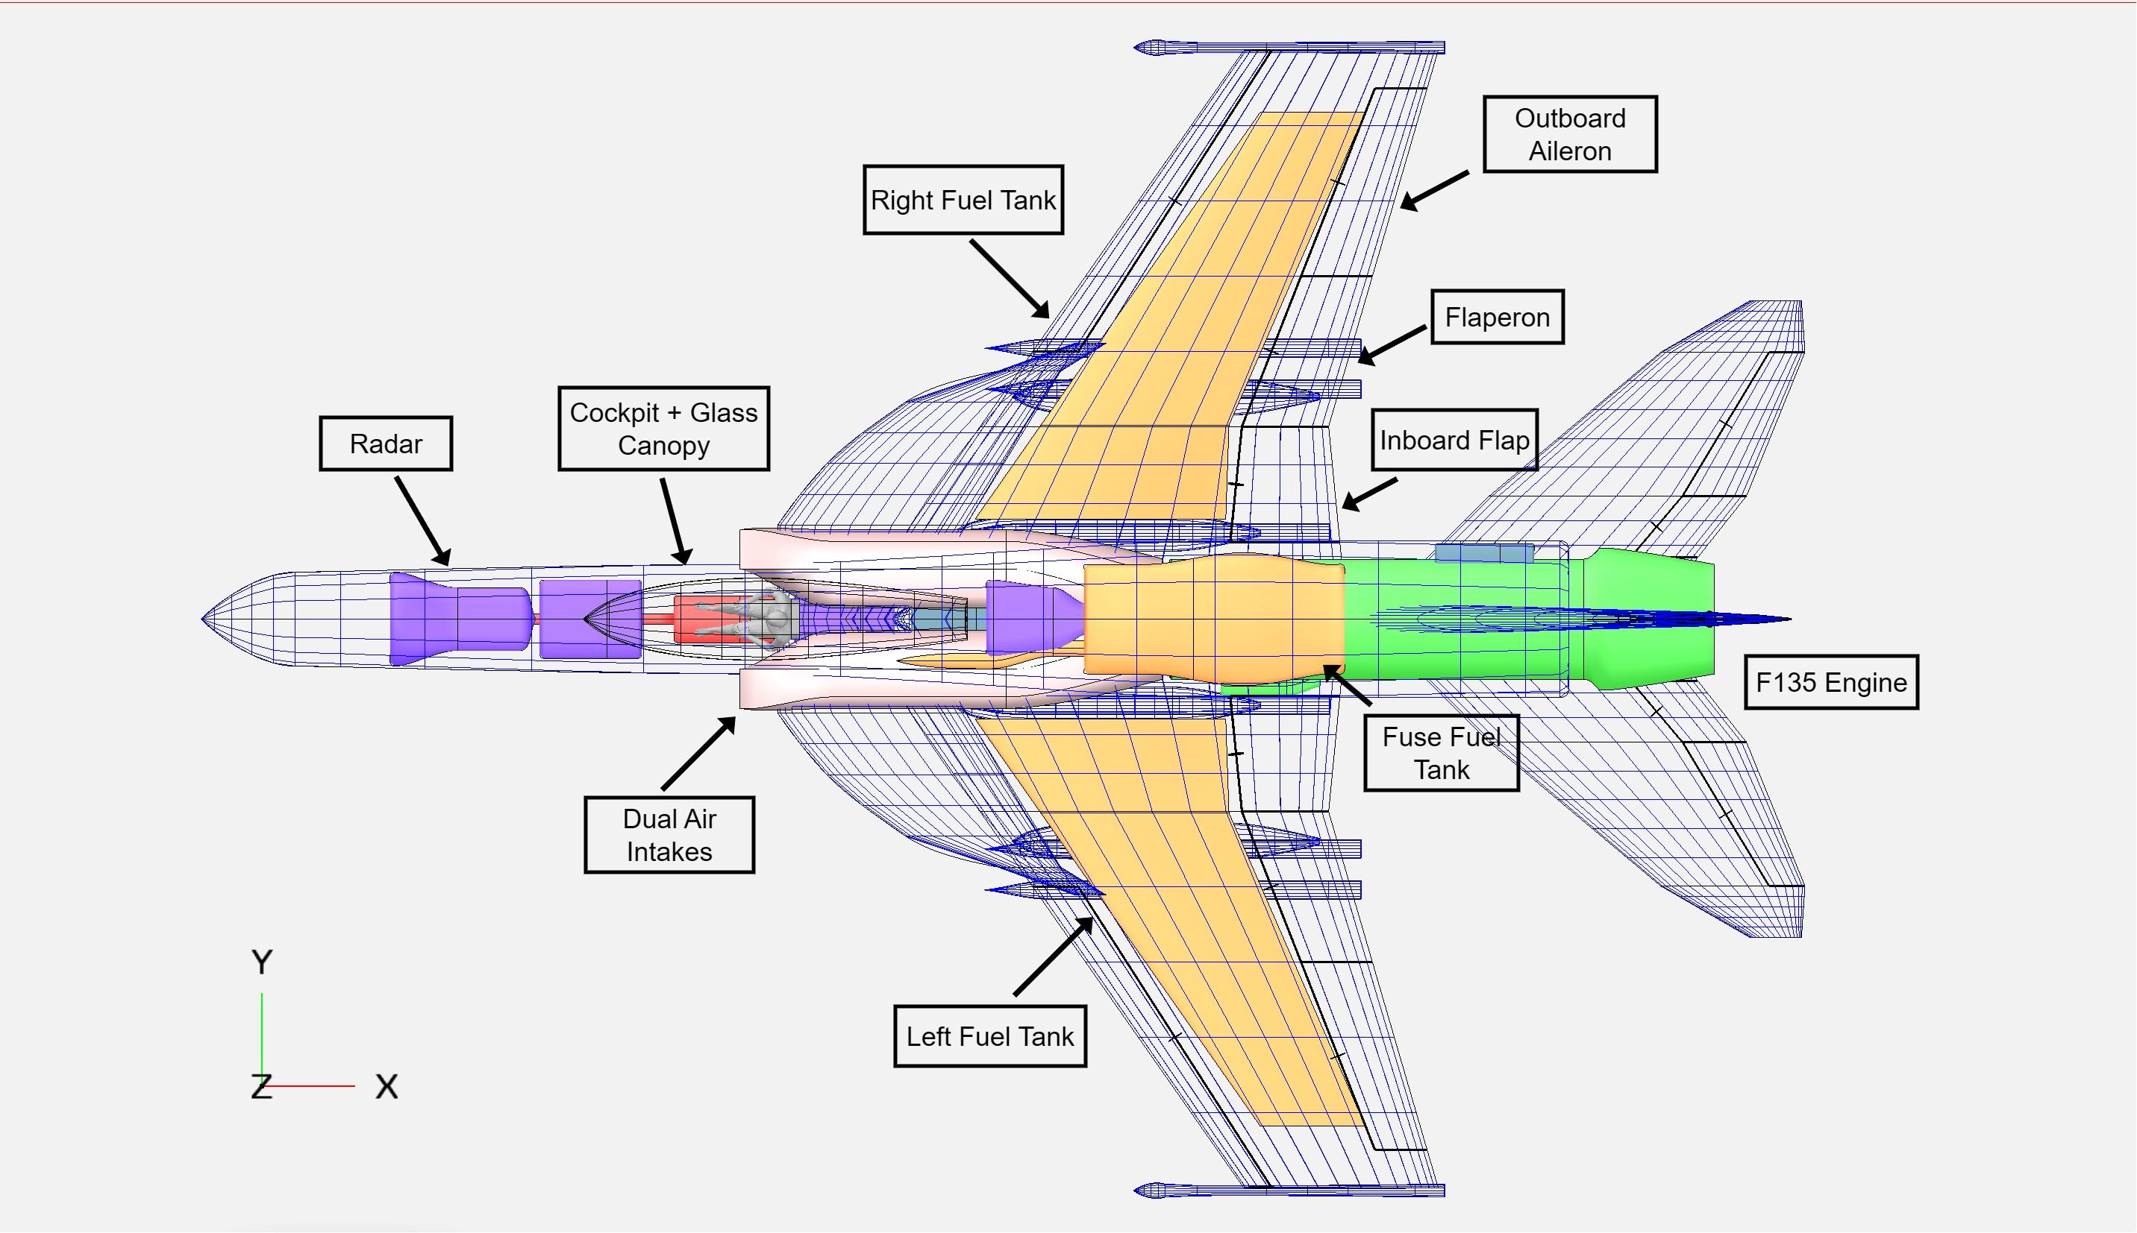
Internal Layout:

Slide 15
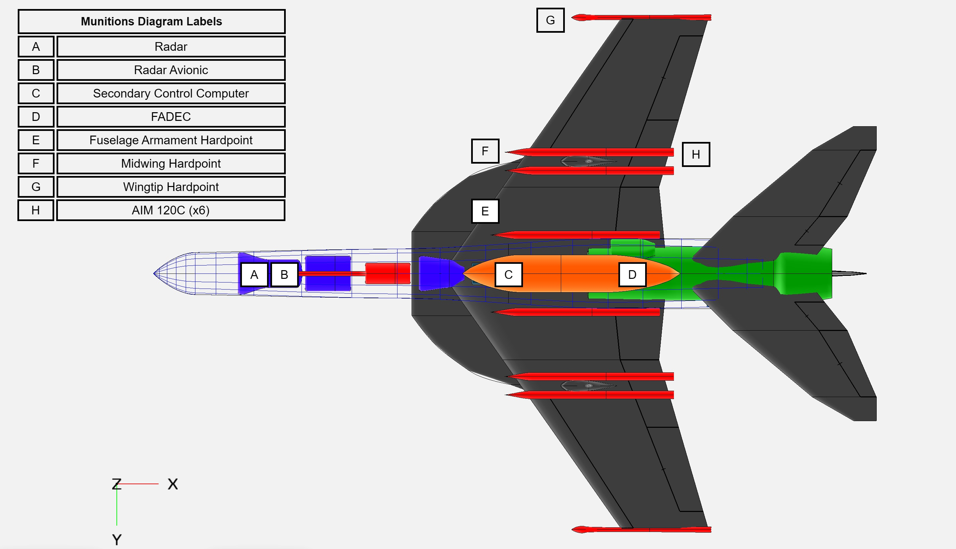
Air Superiority Mission Payload:

Slide 16
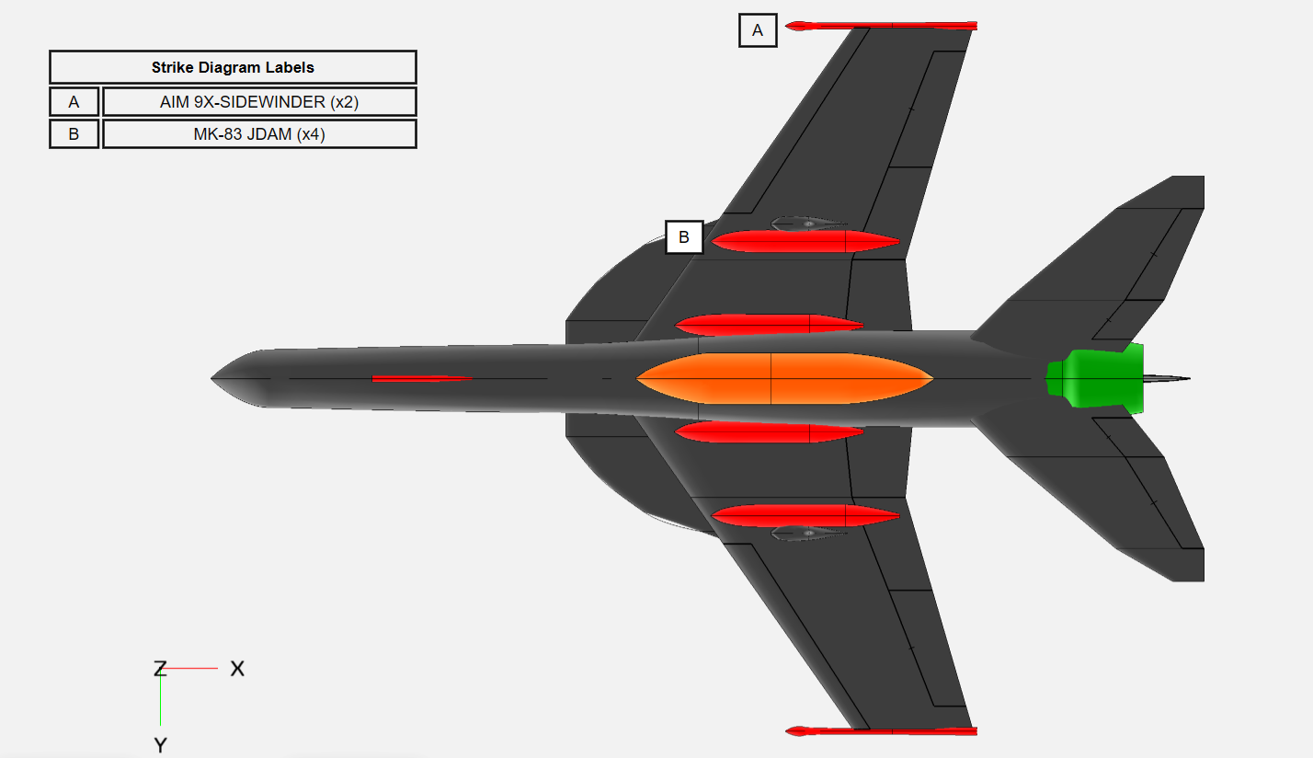
Strike Mission Payload:

Slide 17
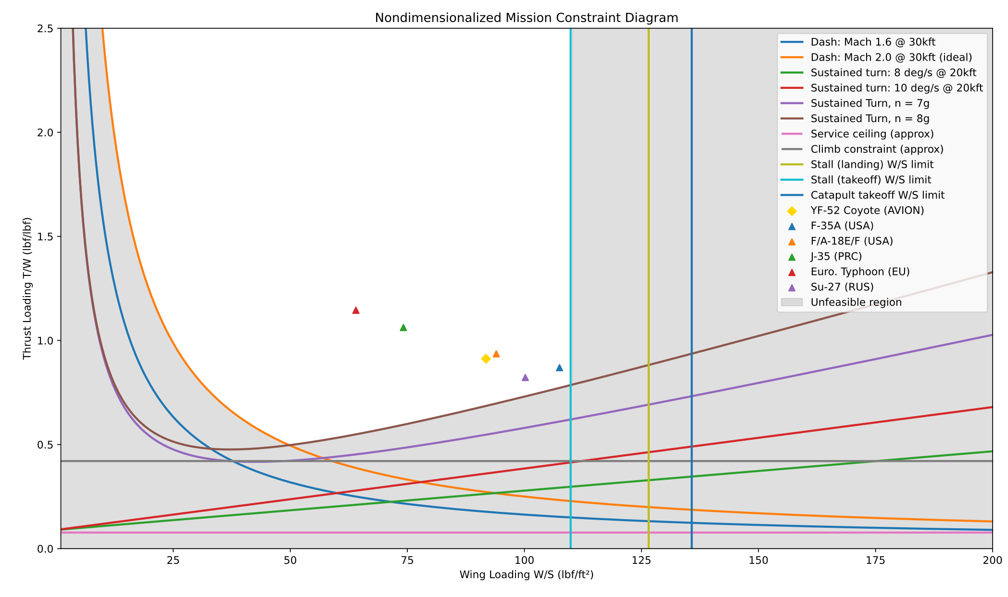
Preliminary Sizing:

Slide 18
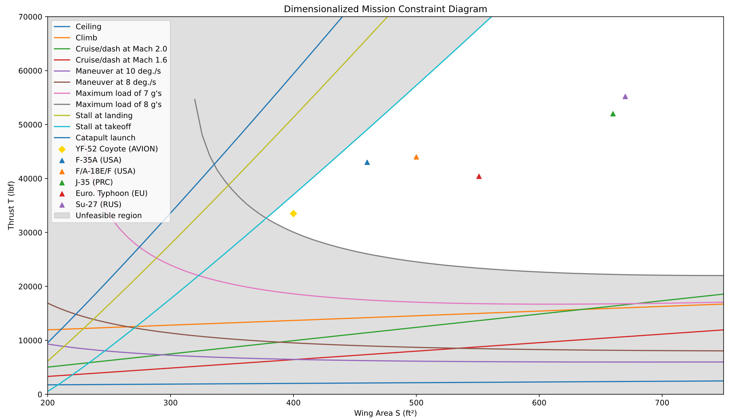
Preliminary Sizing:

Slide 19
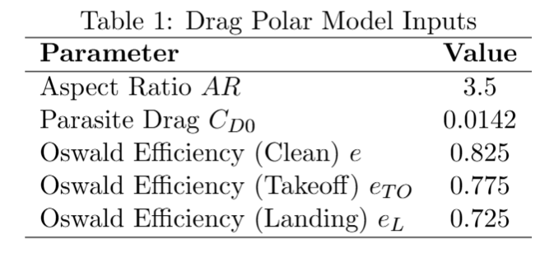
Drag Polar Model
Drag polar used for first-order preliminary sizing
CD0 from OpenVSP parasite drag tool
Induced drag found with finite wing approximation
Notes:
I think this should be collapsed with slide 20 –charlie

Slide 20
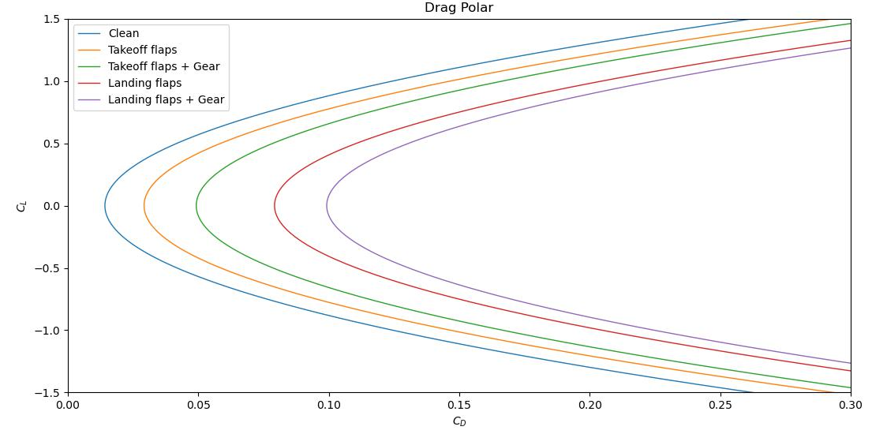
Drag Polar:

Slide 21
Risk Mitigation and Next Steps:
Single Engine:
APU in preliminary selection phase
Light fighter:
Survivability will be paramount in detail design

Slide 22
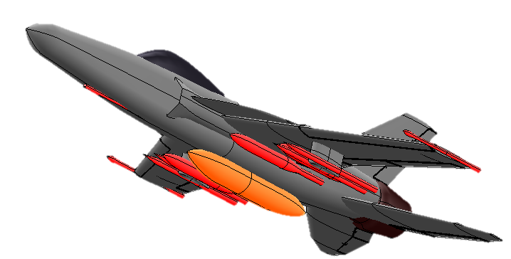
Thank you.

